Slide 1
Understanding and CALLING LARGE LANGUAGE MODEL APIs FROM PYTHON john shipway December 5, 2024

Slide 2

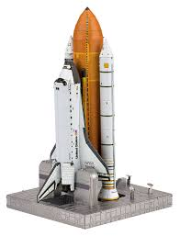

What is model?
A model is a representation of reality that we can use to study, test, better understand a system, and predict outcomes.

Slide 3
What is a statistical model?
A statistical model is a computational engine that predicts outcomes based on historical data.
ANSWER:
PROBABILITY OF FRAUD
INPUT DATA
CHARGE AMT
CREDIT CARD FRAUD
STATISTICAL MODEL
LAST CHARGE AMT
LAST CHARGE TIME
.82
SWIPE LOCATION
CUSTOMER AGE
CUSTOMER INCOME
Will this person pay back their loan?
What will the temperature be tomorrow?
Is this credit card transaction fraudulent?

Slide 4
What is a LARGE LANGUAGE model (LLM)?
A large language model is a type of statistical model where the input is a text-based question or prompt, and the output is a text-based response. The data used to train the model is much of the human language stored on the Internet. The natural phenomena we are representing is human language and human communication.
ANSWER
Here's how you can do it:
1. Open the Crontab. To edit the cron jobs for the current user, run: crontab -e
This opens the crontab file for editing. If it's your first time, you'll be prompted to choose a text editor.
2. Add the Cron Job
To schedule a program to run daily at 2 a.m., add the following line to the crontab file:
0 2 * * * /path/to/your/program
PROMPT
LARGE LANGUAGE MODEL
in Linux, how do I schedule a program to run every day at 2 a.m.?

Slide 5
Large Language models are really working with numbers
The prompt is encoded into a list of numbers (a vector) for each word. That list of vectors is sent to the LLM. The response from the LLM is a list of numbers for each word in the response, which is converted back into words that humans can read. Training with the vast corpus of text on the internet, the results are remarkable.
ANSWER
PROMPT
LARGE LANGUAGE MODEL
.85 | .73 | .76 | .45 | .59 | …
.62 | .54 | .22 | .32 | .56 | …
.11 | .34. | .78 | .87 | .34 | …
.09 | .99 | .60 | .78 | .76 | …
… | … | … | … | … | …
Here's how you can do it:
1. Open the Crontab. To edit the cron jobs for the current user, run: crontab –e.
in Linux, how do I…
.85 | .73 | .76 | .45 | .59
.62 | .54 | .22 | .32 | .56
.11 | .34. | .78 | .87 | .34
.09 | .99 | .60 | .78 | .76
… | … | … | … | …

Slide 6
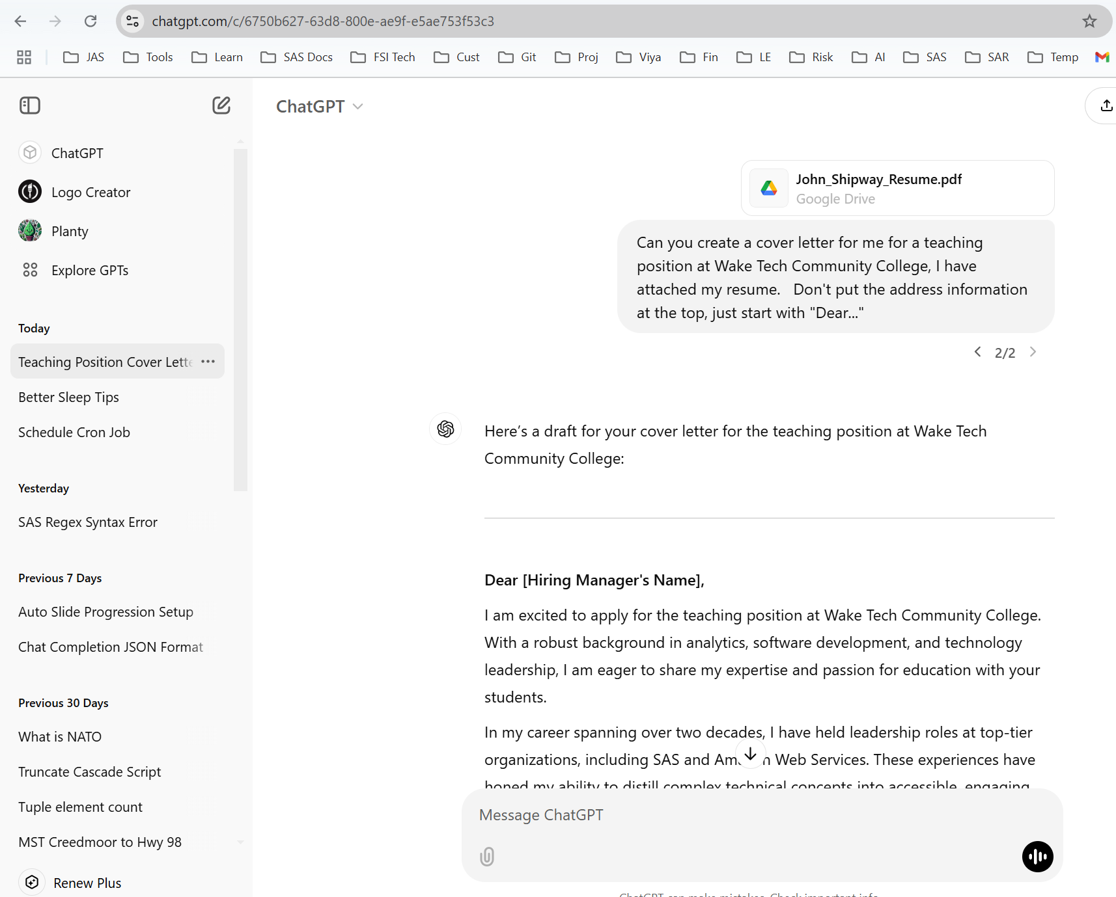
How people typically use large Language models:
CHATGPT Website
LARGE LANGUAGE MODEL

Slide 7
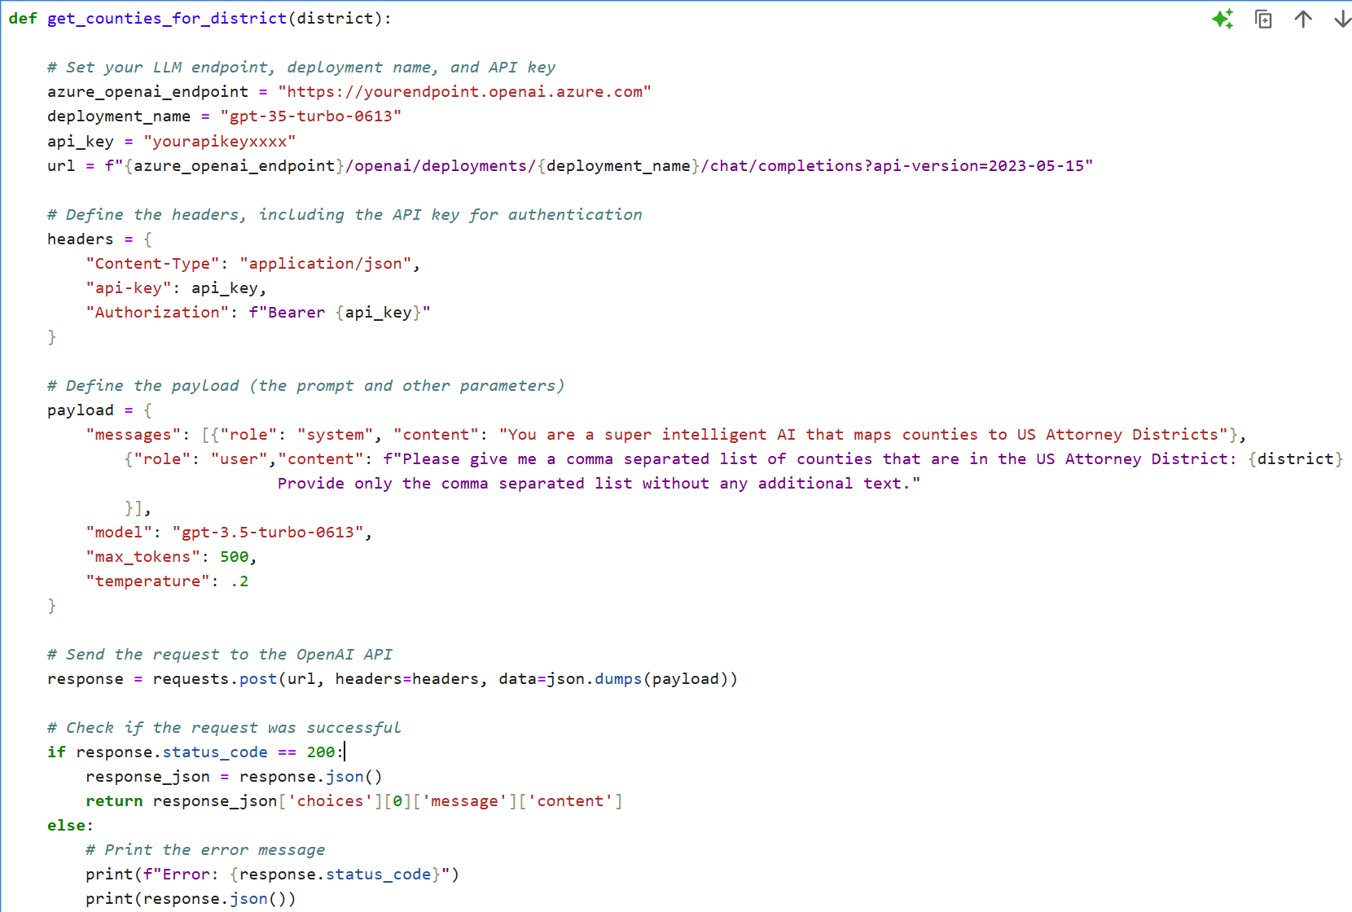
We can get the same LLM functionality for our software using llm APIs. An example in python:
Python program
LARGE LANGUAGE MODEL
Uses: Chat Bots, Conversations, Help Desks, Summarization, Entity extraction, Batch Classification, Augmenting existing data. Basically anything you can imagine…

Slide 8
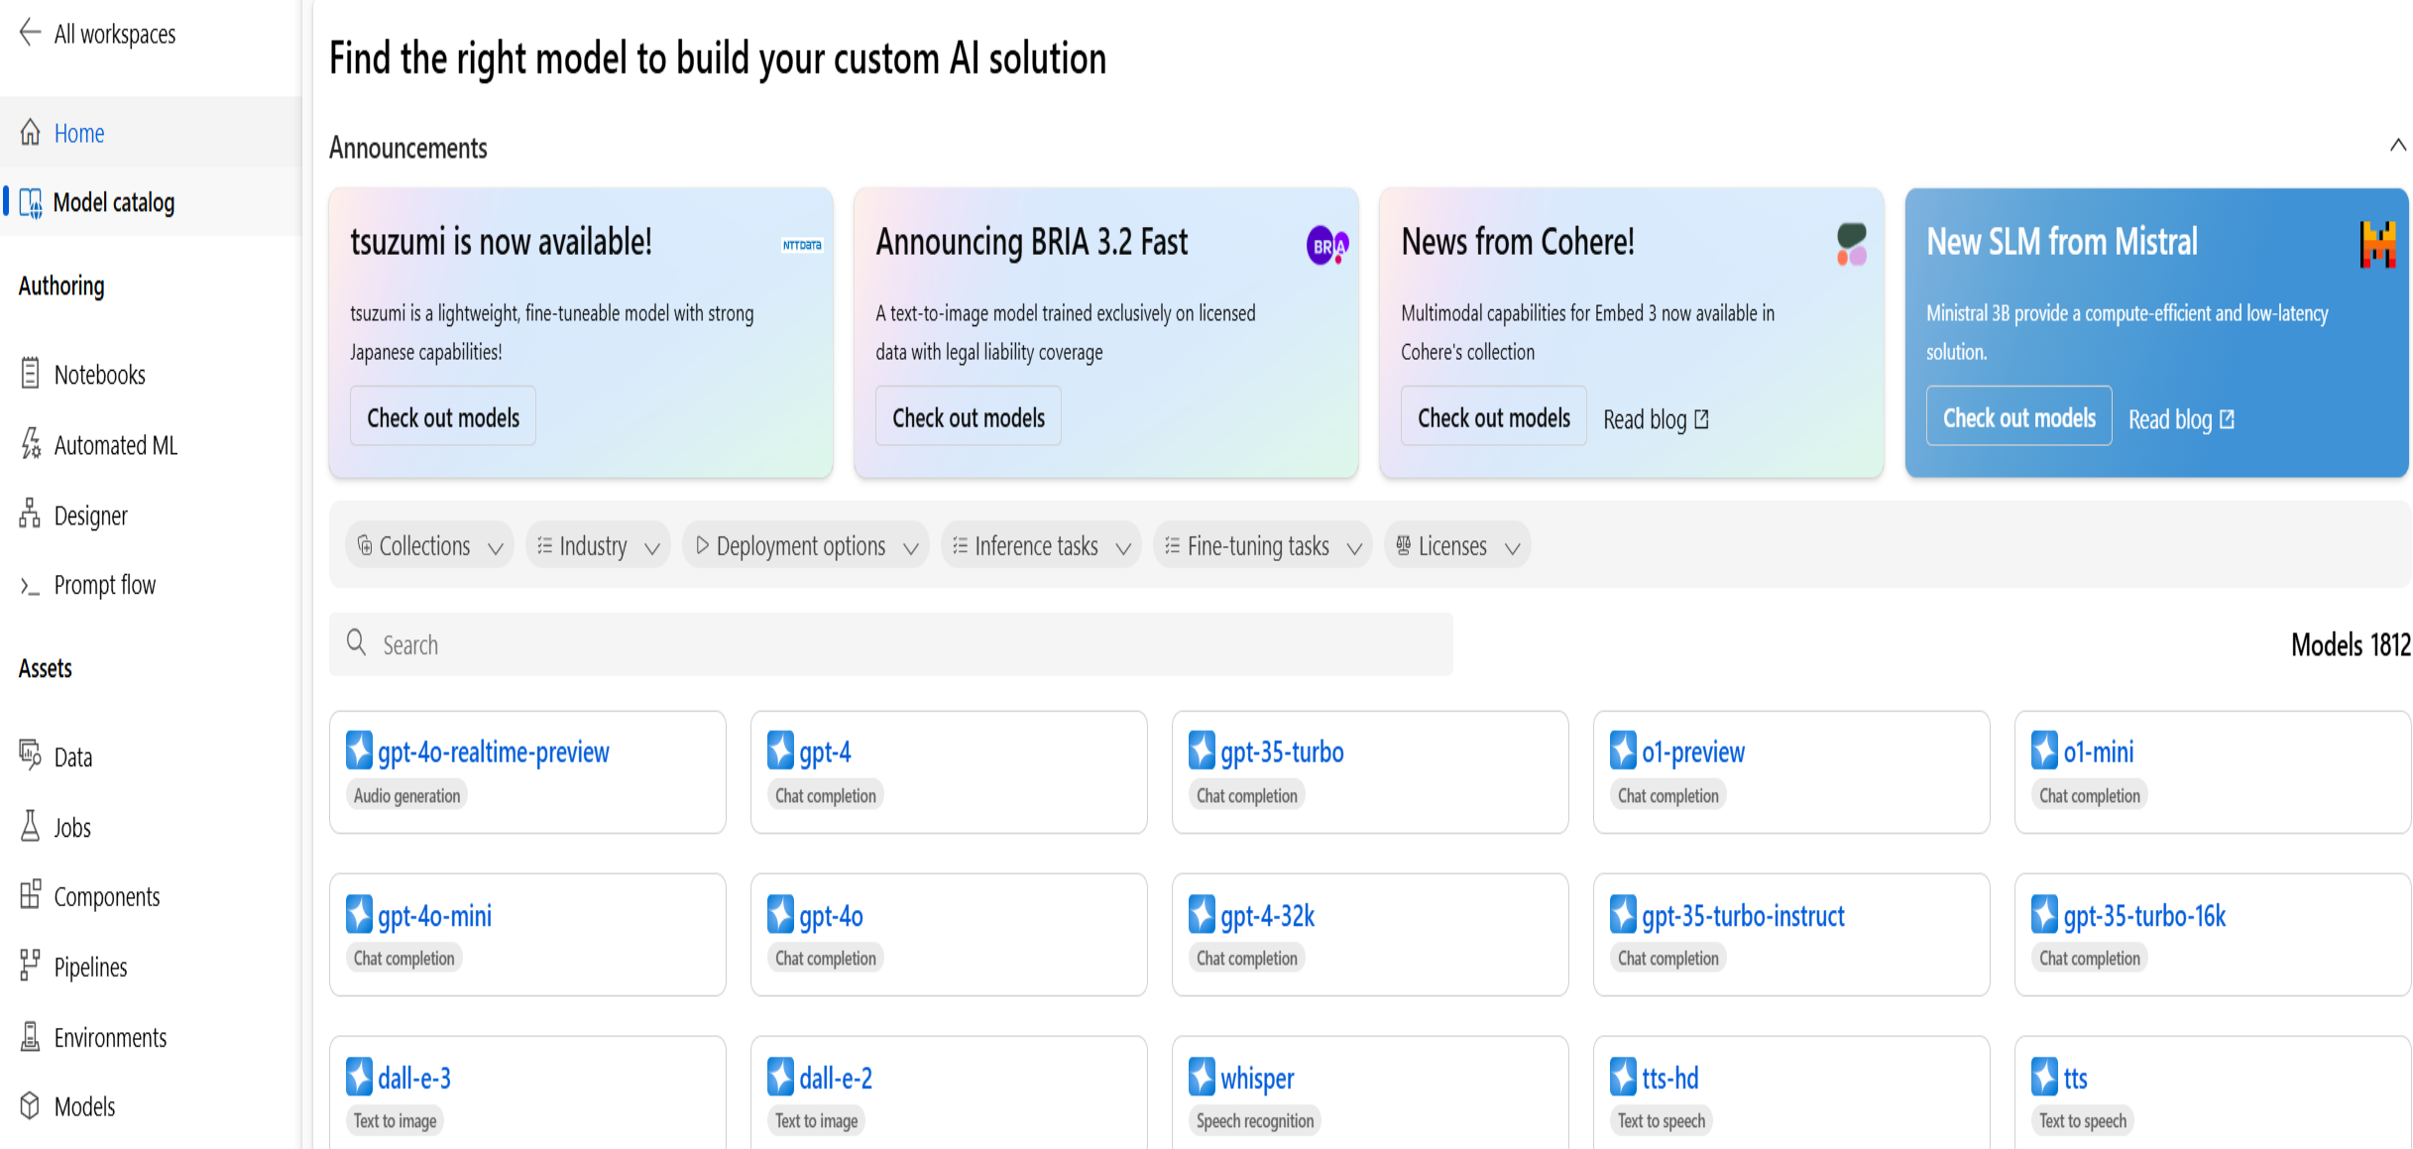
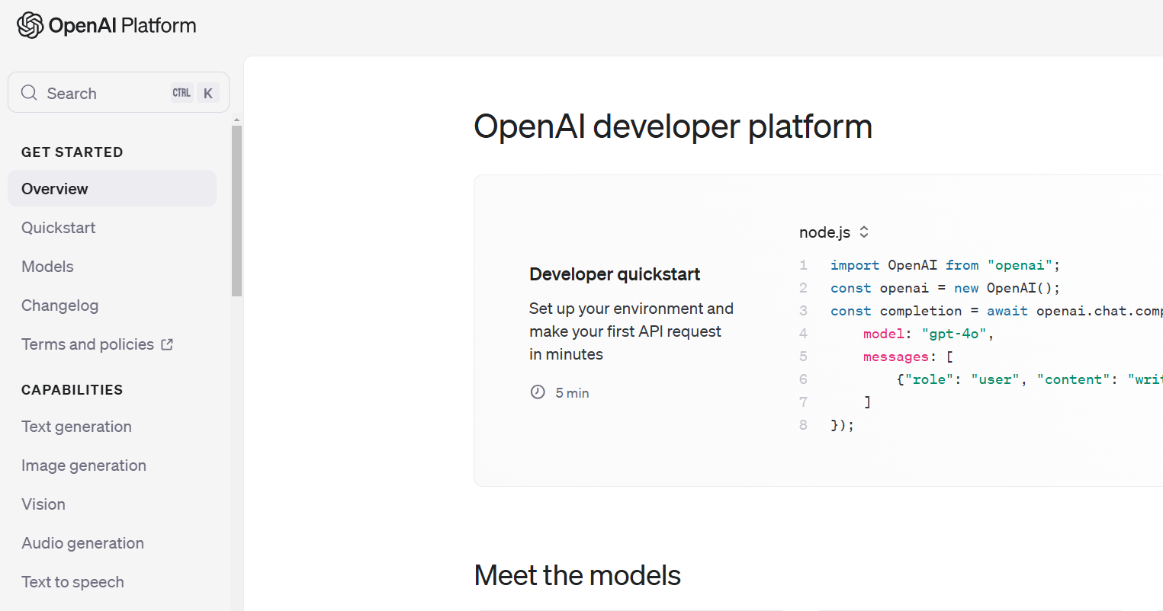
What You’ll Need FIRST: Access to an LLM API
Azure AI Machine Learning Studio Model Catalog
OpenAI Developer Platform

Slide 9

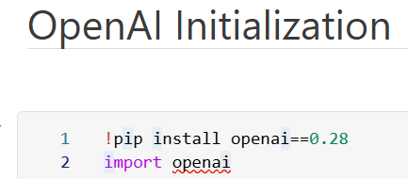
Now, We’re READY To CODE
These are the only two python packages you will need:
You can also use the OpenAI package and objects, but…
OpenAI package dependencies can be cumbersome (had to pin version in example below)
The REST Interface via the requests package is already very simple to use
Swapping in another vendor’s LLMs (i.e. Meta Llama, Claude) is far easier with REST interface as those other models provide REST interfaces as well

Slide 10
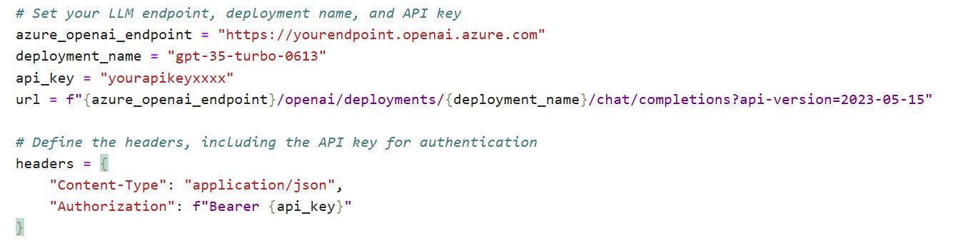
LLM API Initialization
The LLM API URL variable and api_key will wire your code you to your own LLM API
Security and Billing are enabled in this way

Slide 11
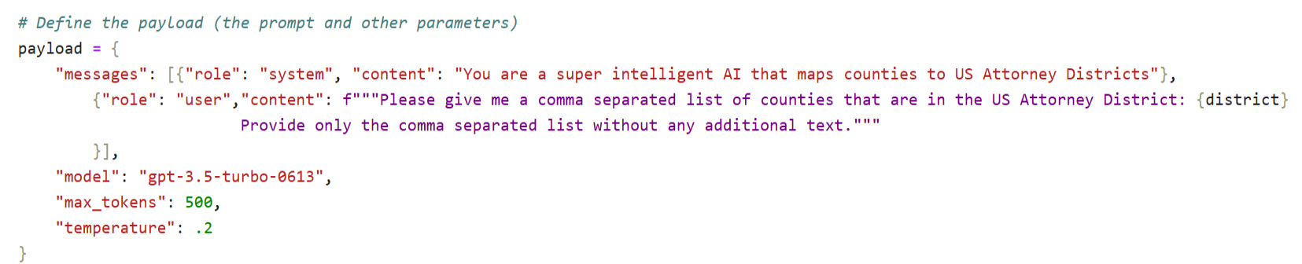
cREATING THE LLM PROMPT
This creates the prompt that the LLM is going to respond to
Max tokens is essentially the number of words the response can contain
Remember that most models have a maximum number of tokens for request + response (i.e. 8K), so keep this in mind when setting max_tokens
Temperature is a “creativity setting”. More temperature for more variation in responses, less temp for more consistent responses.
Note the specific instructions and low temperature setting, in this case we want a consistent format for each response.

Slide 12
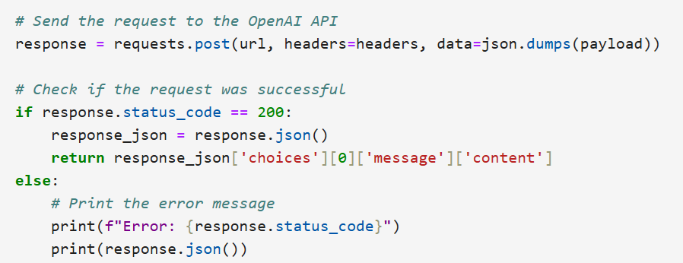
Calling the LLM API and EXTRACTING RESULTS
Using the URL, api_key, and prompt, call the LLM API
The response will be in Javascript Object Notation (json). We can parse out the specific text of the response via response_json[‘choices’][0][‘message’][‘content’]

Slide 13
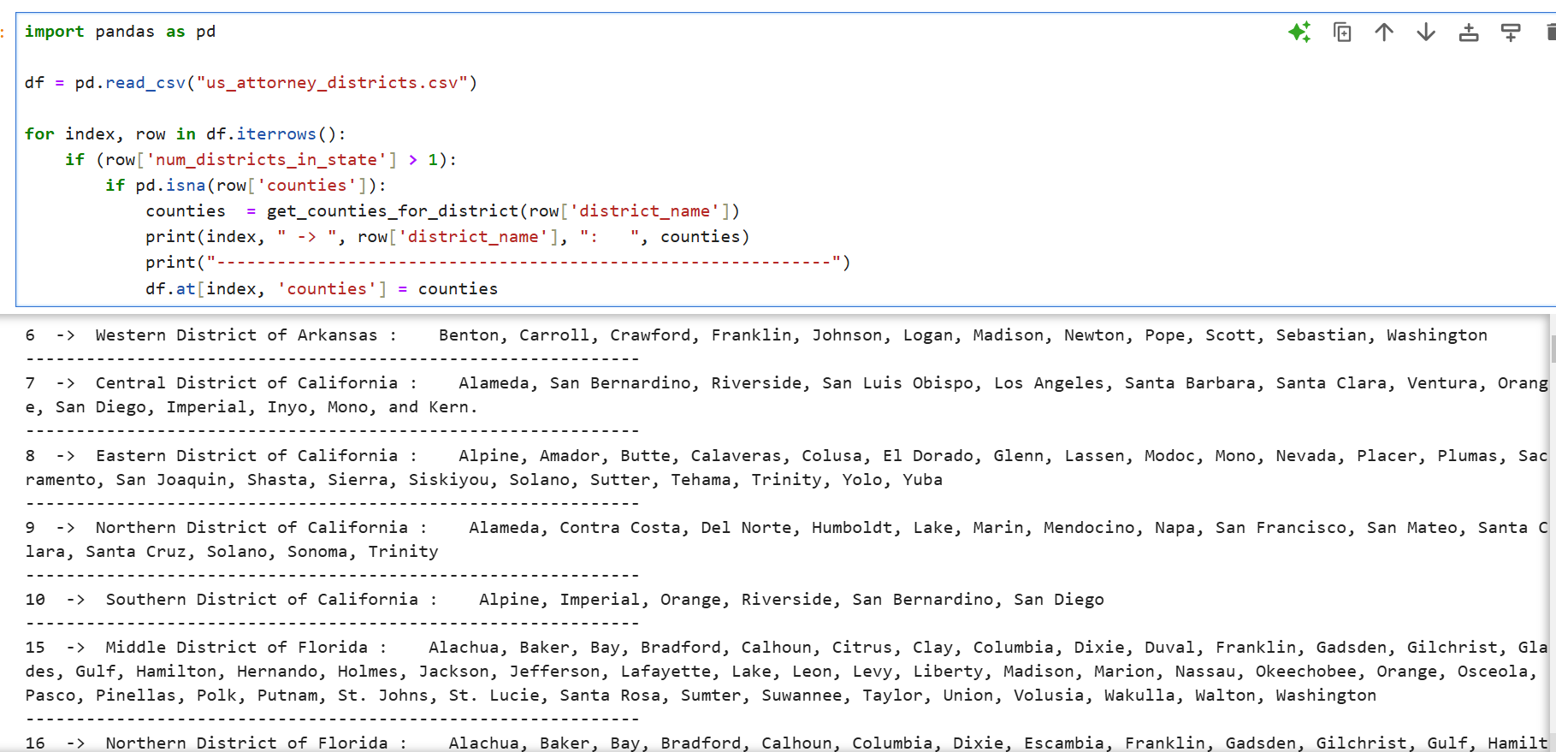

We can now call the Function in a loop and compete our task

Slide 14
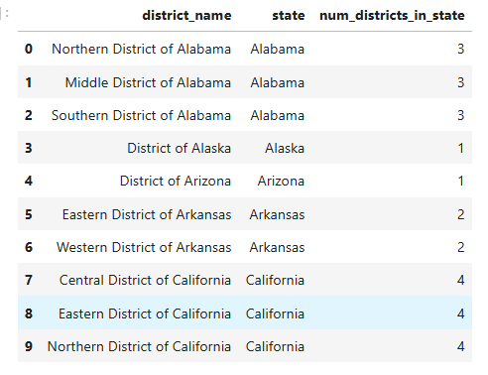
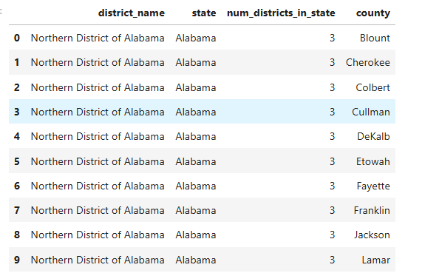
Our Final Result
LLM Enabled Python Function

Slide 15
What HAVE WE LEARNED TODAY
Models are representations of some phenomenon or system in our world
Large Language Models (LLMs) are representations of human communication that learn how to communicate via numerical representations of much of the text on the Internet
Humans can interact with LLMs through websites like chatgpt.com
Computer Programs can interact with LLMs via REST based APIs from Open AI and cloud providers like Microsoft Azure and AWS.

Slide 16
Resources
You can find the code and data for this lesson and this powerpoint here:
https://github.com/jshipway/jupyter-notebooks

Slide 17
thank you

Slide 18
Questions?

